Slide 1


Kernel Games: The Ballad of Offense and Defense

Slide 2


About
Researcher & Developer
Creating open source offensive tools
Nidhogg
Sandman
Cronos
Posting my research @ https://idov31.github.io
Feel free to review the projects and reach out!

Slide 3
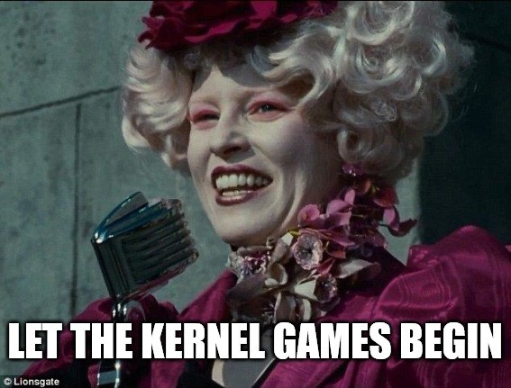
Agenda
Rootkit Methodologies
Hiding injected DLL
Dumping credentials
Removing callbacks of AVs/EDRs
Integration with Mythic C2
What is Mythic C2
Practical use with Athena and Nidhogg (Demo)
Detecting Rootkits
Kernel callbacks tampering
ETWTI tampering
IRP Hooking (Demo)

Slide 4
Rootkit Methodologies

Slide 5



Hiding a module
Hiding EXE or DLL
Evading manual analysis
Evading automatic analysis

Slide 6
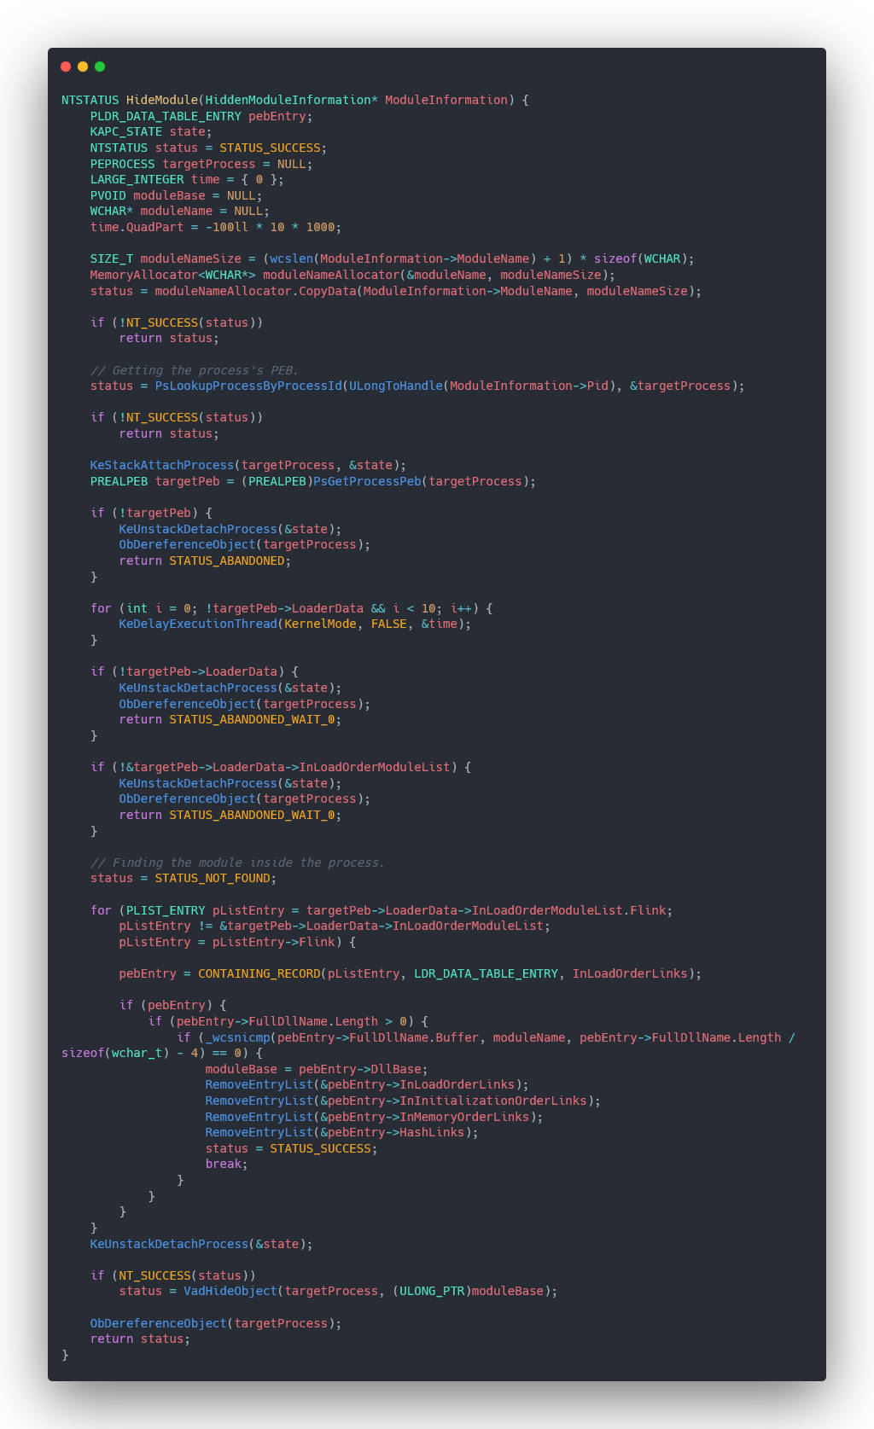
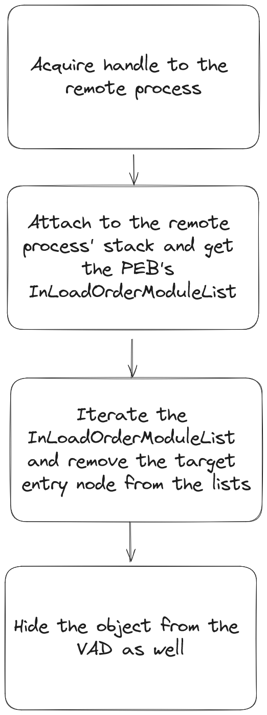

Hiding a module
Notes:
Explain about the process, that first attaching to the process’ stack to be able to read the PEB, then using the loader data to iterate the InLoadOrderModuleList and when the entry is found it is being removed from InLoadedOrderLinks, InMemoryOrderLinks, InInitializationOrderLinks and HashLinks, if it is done successfully it will hide also the VAD entry because some tools (i.e. System Informer (previously process hacker)) is iterating the VAD.

Slide 7
Hiding a module
Notes:
Explain about the process, that first attaching to the process’ stack to be able to read the PEB, then using the loader data to iterate the InLoadOrderModuleList and when the entry is found it is being removed from InLoadedOrderLinks, InMemoryOrderLinks, InInitializationOrderLinks and HashLinks, if it is done successfully it will hide also the VAD entry because some tools (i.e. System Informer (previously process hacker)) is iterating the VAD.

Slide 8
Hiding a module
Notes:
Explain about the process, that first attaching to the process’ stack to be able to read the PEB, then using the loader data to iterate the InLoadOrderModuleList and when the entry is found it is being removed from InLoadedOrderLinks, InMemoryOrderLinks, InInitializationOrderLinks and HashLinks, if it is done successfully it will hide also the VAD entry because some tools (i.e. System Informer (previously process hacker)) is iterating the VAD.

Slide 9
Hiding a module
Notes:
Explain about the process, that first attaching to the process’ stack to be able to read the PEB, then using the loader data to iterate the InLoadOrderModuleList and when the entry is found it is being removed from InLoadedOrderLinks, InMemoryOrderLinks, InInitializationOrderLinks and HashLinks, if it is done successfully it will hide also the VAD entry because some tools (i.e. System Informer (previously process hacker)) is iterating the VAD.

Slide 10
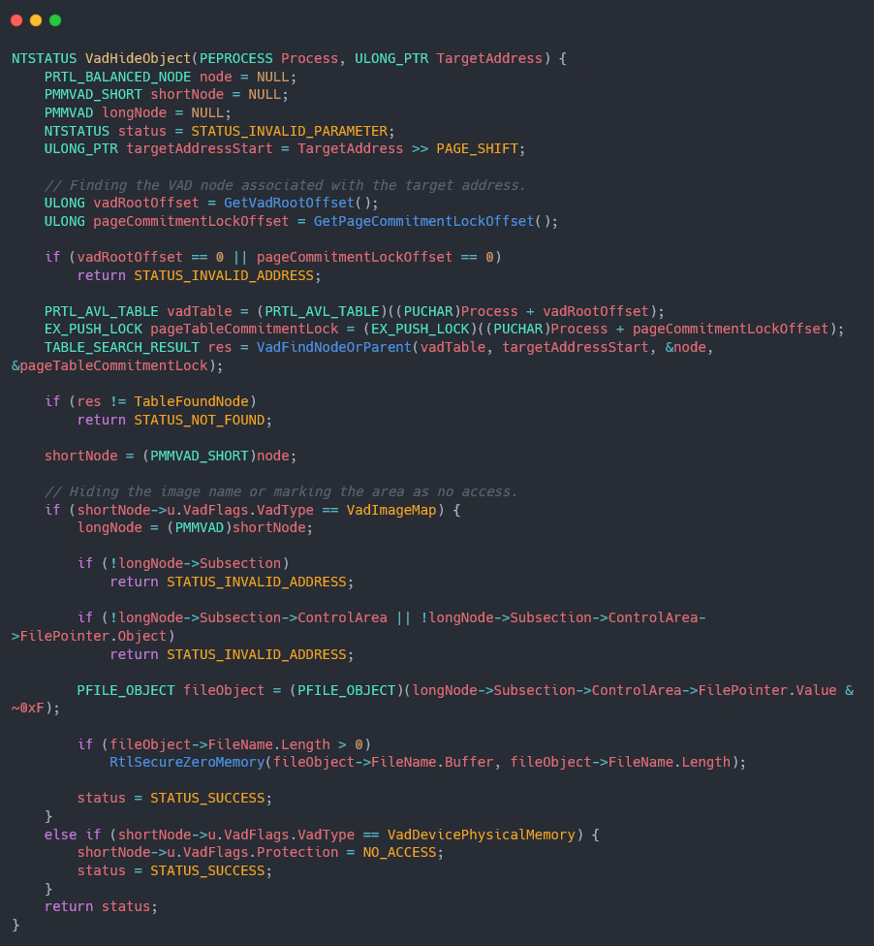
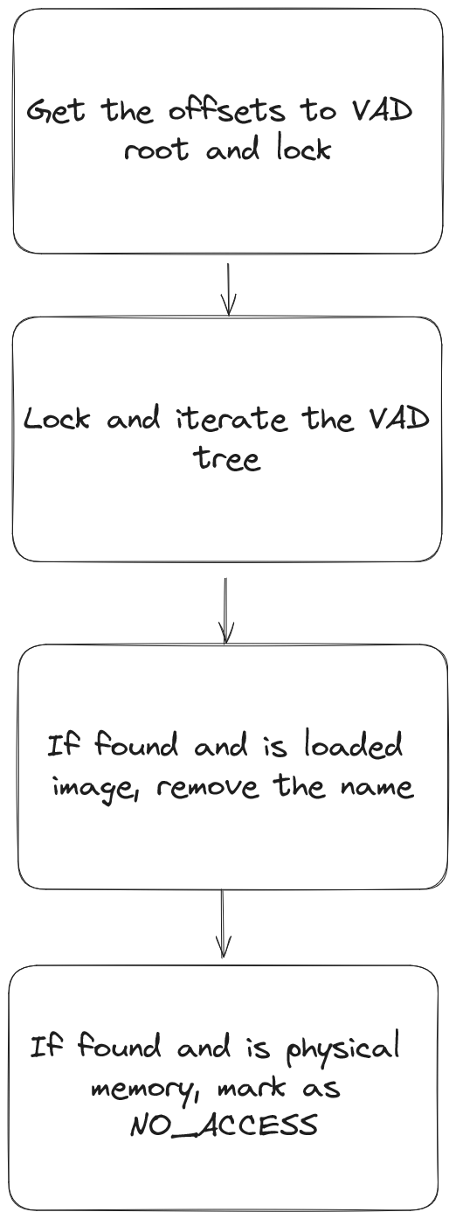
Hiding a module
Notes:
Explain about the process, that first attaching to the process’ stack to be able to read the PEB, then using the loader data to iterate the InLoadOrderModuleList and when the entry is found it is being removed from InLoadedOrderLinks, InMemoryOrderLinks, InInitializationOrderLinks and HashLinks, if it is done successfully it will hide also the VAD entry because some tools (i.e. System Informer (previously process hacker)) is iterating the VAD.

Slide 11
Hiding a module
Notes:
Explain about the process, that first attaching to the process’ stack to be able to read the PEB, then using the loader data to iterate the InLoadOrderModuleList and when the entry is found it is being removed from InLoadedOrderLinks, InMemoryOrderLinks, InInitializationOrderLinks and HashLinks, if it is done successfully it will hide also the VAD entry because some tools (i.e. System Informer (previously process hacker)) is iterating the VAD.

Slide 12
Hiding a module
Notes:
Explain about the process, that first attaching to the process’ stack to be able to read the PEB, then using the loader data to iterate the InLoadOrderModuleList and when the entry is found it is being removed from InLoadedOrderLinks, InMemoryOrderLinks, InInitializationOrderLinks and HashLinks, if it is done successfully it will hide also the VAD entry because some tools (i.e. System Informer (previously process hacker)) is iterating the VAD.

Slide 13
Hiding a module
Notes:
Explain about the process, that first attaching to the process’ stack to be able to read the PEB, then using the loader data to iterate the InLoadOrderModuleList and when the entry is found it is being removed from InLoadedOrderLinks, InMemoryOrderLinks, InInitializationOrderLinks and HashLinks, if it is done successfully it will hide also the VAD entry because some tools (i.e. System Informer (previously process hacker)) is iterating the VAD.

Slide 14



Advantages of dumping credentials from the kernel
Remain undetected by EDRs and AVs
No need to acquire special permissions or beat PPL
Done in almost identical way like from user mode

Slide 15
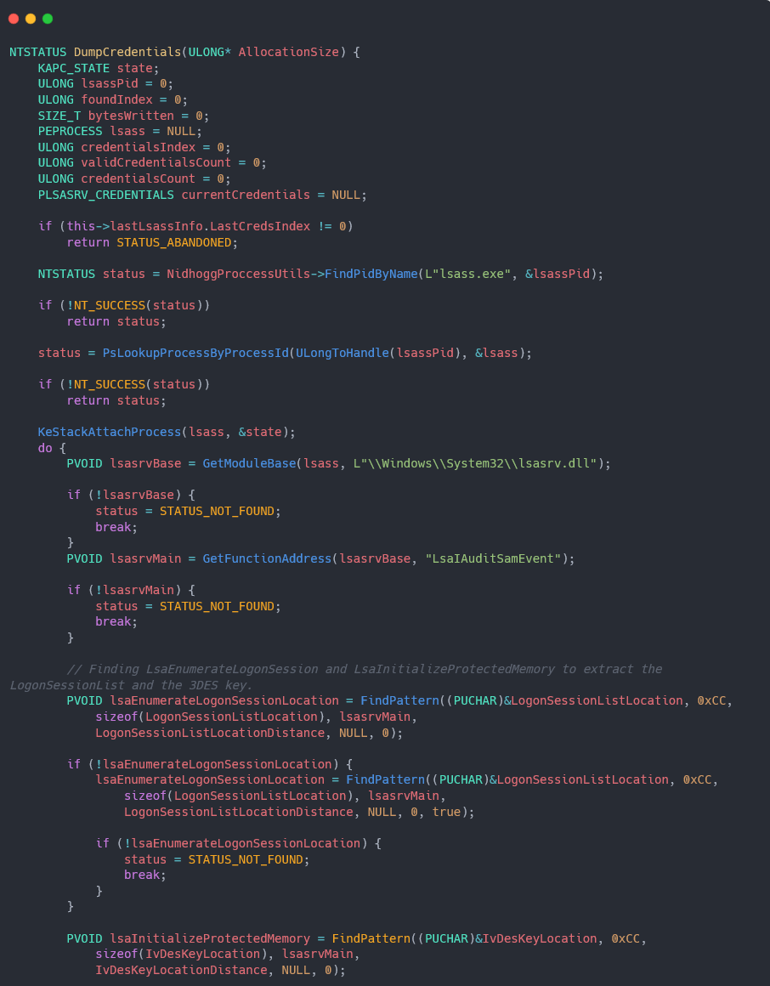
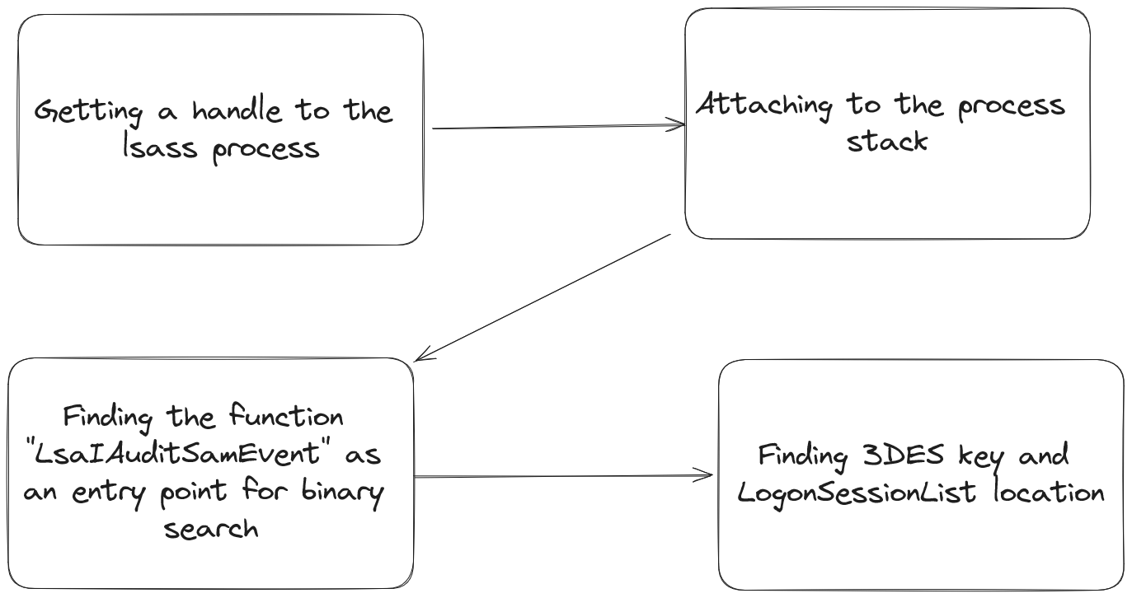
Dumping Credentials
Notes:
Explain about binary searching and signature making
Explain that need to find the DES key and the credentials
Explain how it is transferred to the user

Slide 16
Dumping Credentials
Notes:
Explain about binary searching and signature making
Explain that need to find the DES key and the credentials
Explain how it is transferred to the user

Slide 17
Dumping Credentials
Notes:
Explain about binary searching and signature making
Explain that need to find the DES key and the credentials
Explain how it is transferred to the user

Slide 18
Dumping Credentials
Notes:
Explain about binary searching and signature making
Explain that need to find the DES key and the credentials
Explain how it is transferred to the user

Slide 19
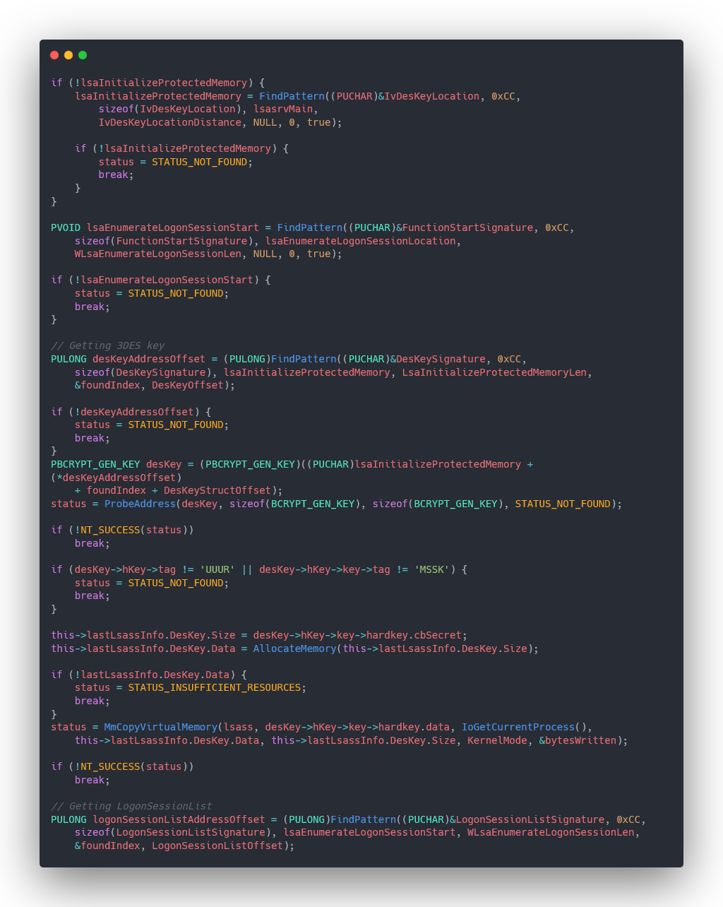
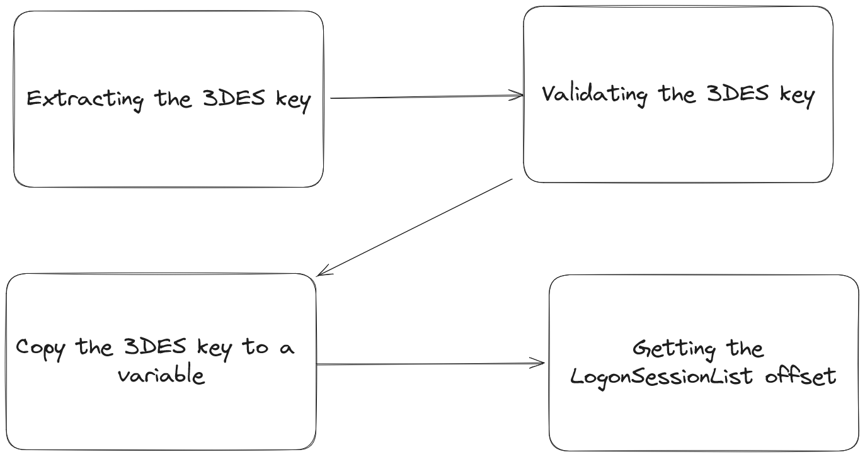
Dumping Credentials
Notes:
Explain about binary searching and signature making
Explain that need to find the DES key and the credentials
Explain how it is transferred to the user

Slide 20
Dumping Credentials
Notes:
Explain about binary searching and signature making
Explain that need to find the DES key and the credentials
Explain how it is transferred to the user

Slide 21
Dumping Credentials
Notes:
Explain about binary searching and signature making
Explain that need to find the DES key and the credentials
Explain how it is transferred to the user

Slide 22
Dumping Credentials
Notes:
Explain about binary searching and signature making
Explain that need to find the DES key and the credentials
Explain how it is transferred to the user

Slide 23
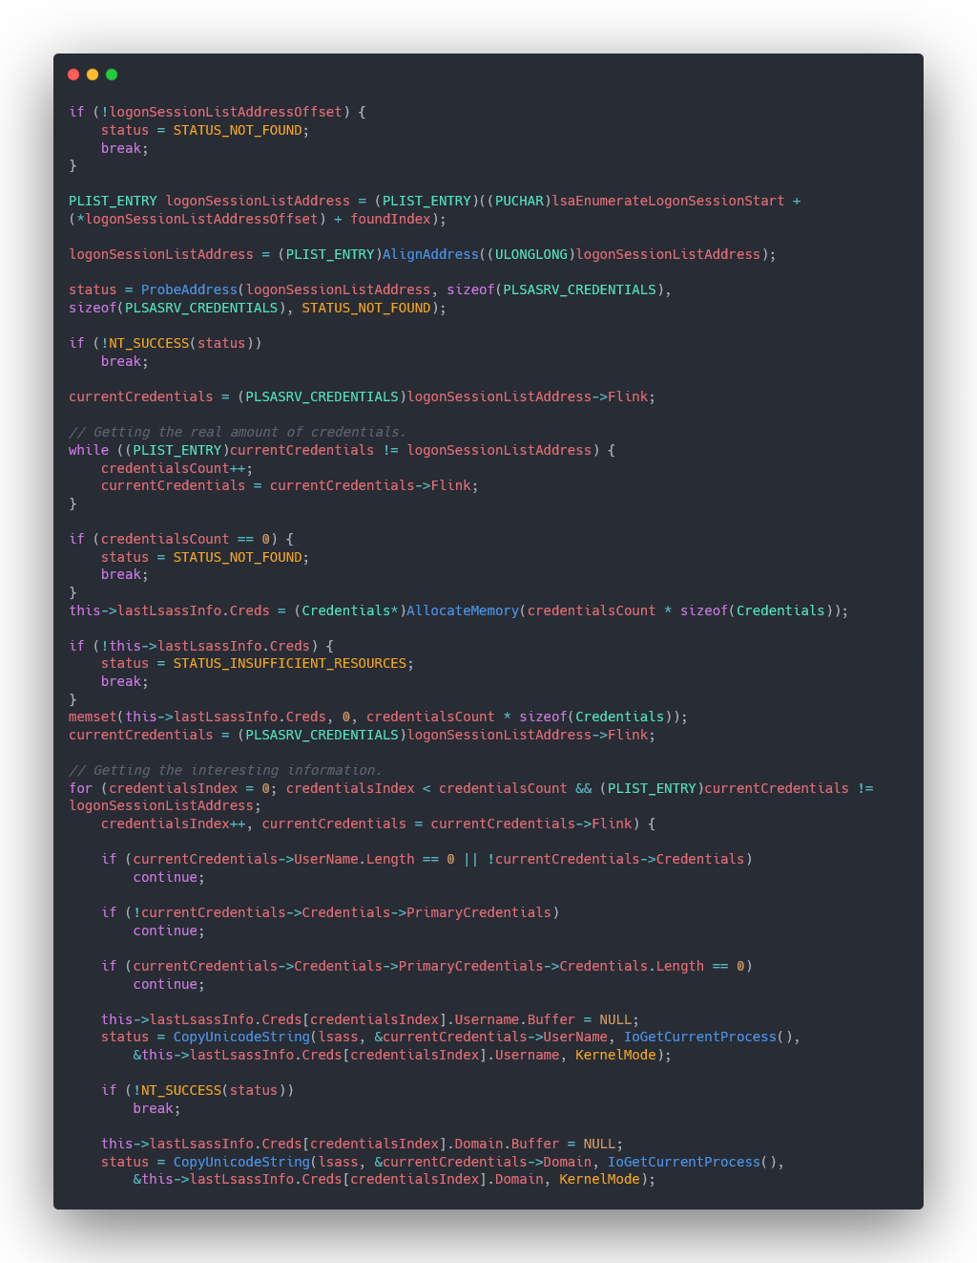
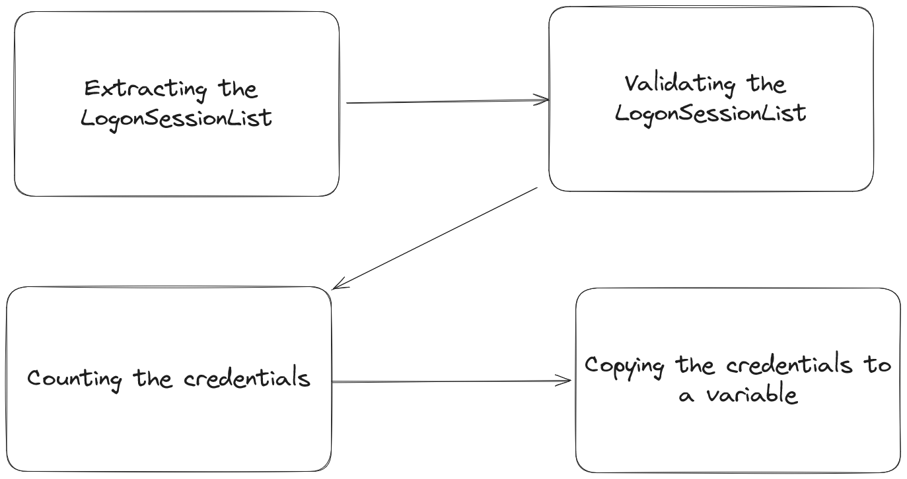
Dumping Credentials
Notes:
Explain about binary searching and signature making
Explain that need to find the DES key and the credentials
Explain how it is transferred to the user

Slide 24
Dumping Credentials
Notes:
Explain about binary searching and signature making
Explain that need to find the DES key and the credentials
Explain how it is transferred to the user

Slide 25
Dumping Credentials
Notes:
Explain about binary searching and signature making
Explain that need to find the DES key and the credentials
Explain how it is transferred to the user

Slide 26
Dumping Credentials
Notes:
Explain about binary searching and signature making
Explain that need to find the DES key and the credentials
Explain how it is transferred to the user

Slide 27
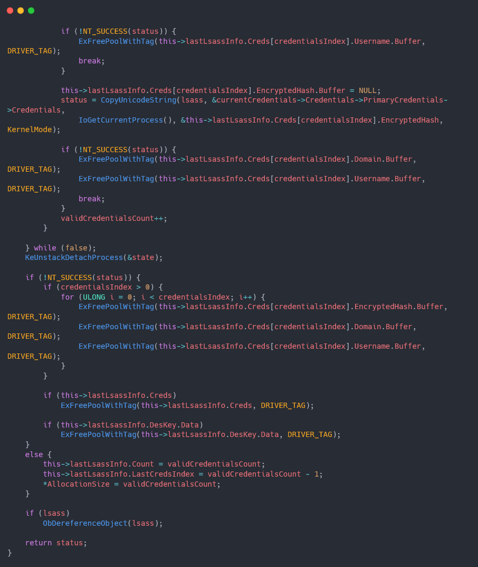
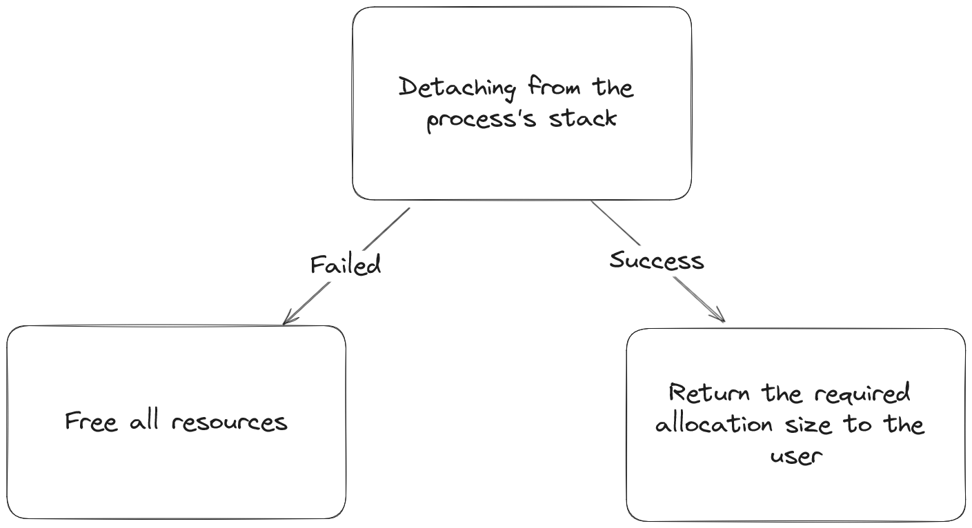
Dumping Credentials
Notes:
Explain about binary searching and signature making
Explain that need to find the DES key and the credentials
Explain how it is transferred to the user

Slide 28
Dumping Credentials
Notes:
Explain about binary searching and signature making
Explain that need to find the DES key and the credentials
Explain how it is transferred to the user

Slide 29
Dumping Credentials
Notes:
Explain about binary searching and signature making
Explain that need to find the DES key and the credentials
Explain how it is transferred to the user

Slide 30



Refreshment on object callbacks
Register pre or post callbacks
Types for Registry keys, files, processes, threads, events, etc.
Enabling disabled callback will cause BSOD
Notes:
Explain what is written on the screen and also add that EDRs/AVs heavily rely on these callbacks to examine

Slide 31
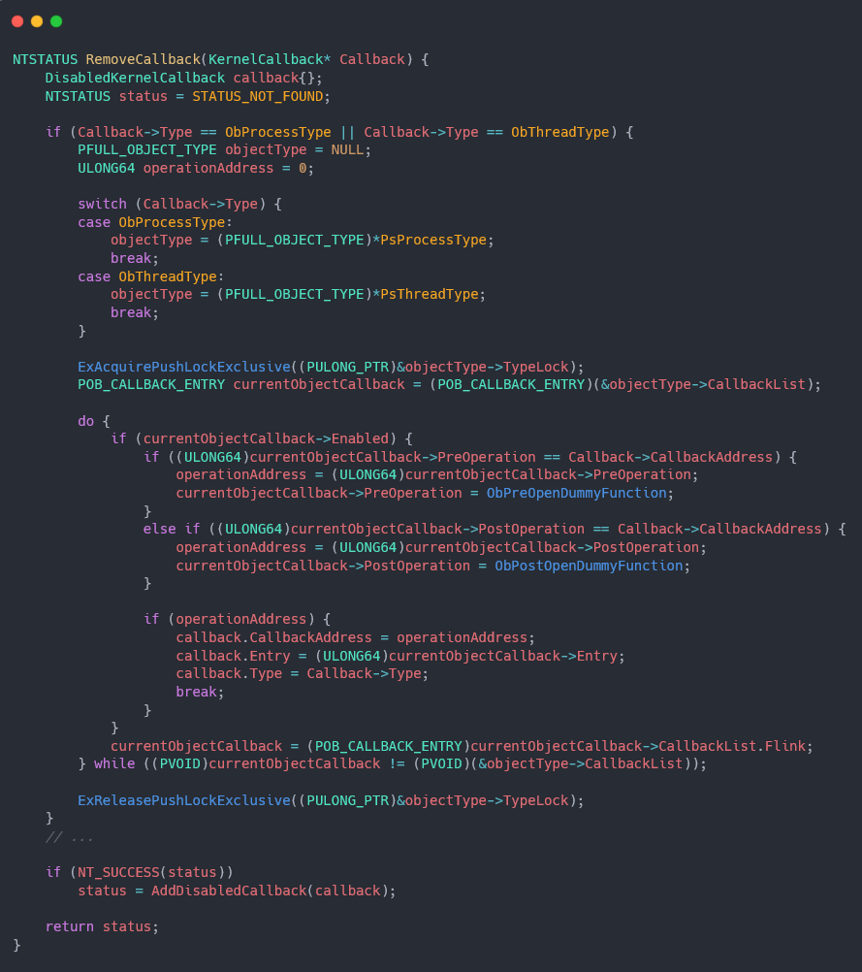
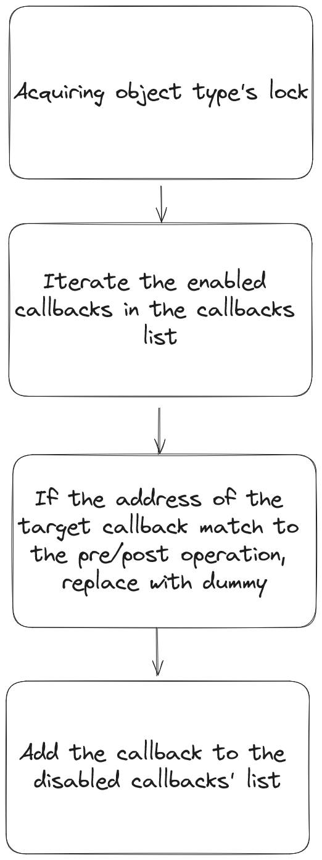
Removing an object callback
Notes:
Explain about the iteration of the callback list, counting how many callbacks there are and matching the driver name to the address Explain about removing an object callback, getting the lock from the object type, iterating over it and if the object callback that should be replaced is found then replace it with dummy that does nothing

Slide 32
Removing an object callback
Notes:
Explain about the iteration of the callback list, counting how many callbacks there are and matching the driver name to the address Explain about removing an object callback, getting the lock from the object type, iterating over it and if the object callback that should be replaced is found then replace it with dummy that does nothing

Slide 33
Removing an object callback
Notes:
Explain about the iteration of the callback list, counting how many callbacks there are and matching the driver name to the address Explain about removing an object callback, getting the lock from the object type, iterating over it and if the object callback that should be replaced is found then replace it with dummy that does nothing

Slide 34
Removing an object callback
Notes:
Explain about the iteration of the callback list, counting how many callbacks there are and matching the driver name to the address Explain about removing an object callback, getting the lock from the object type, iterating over it and if the object callback that should be replaced is found then replace it with dummy that does nothing

Slide 35
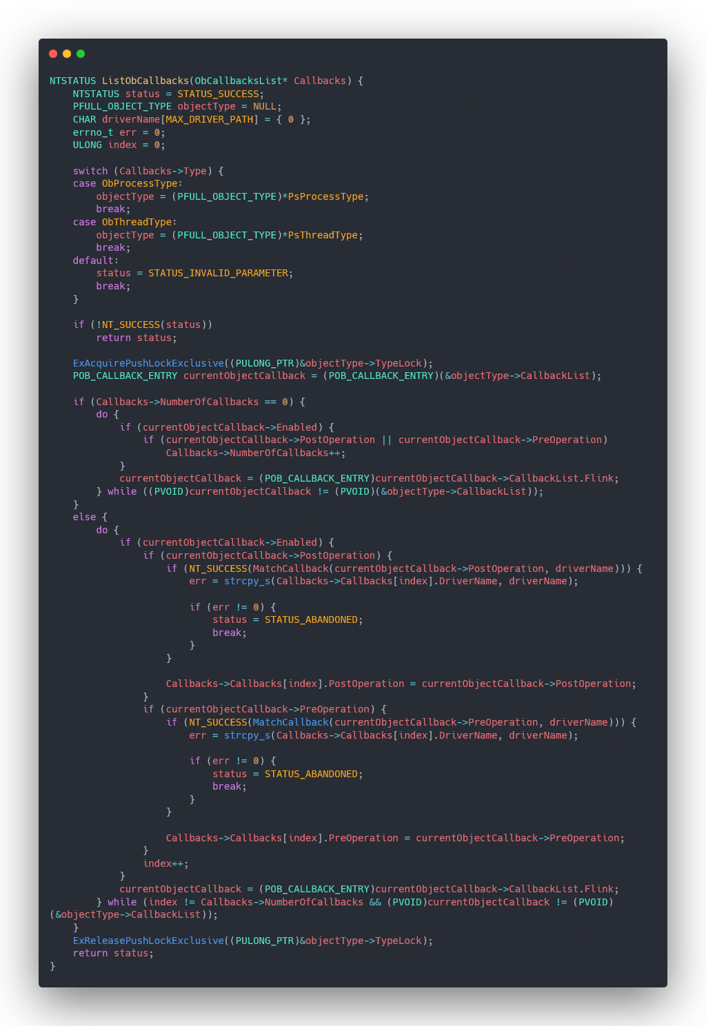
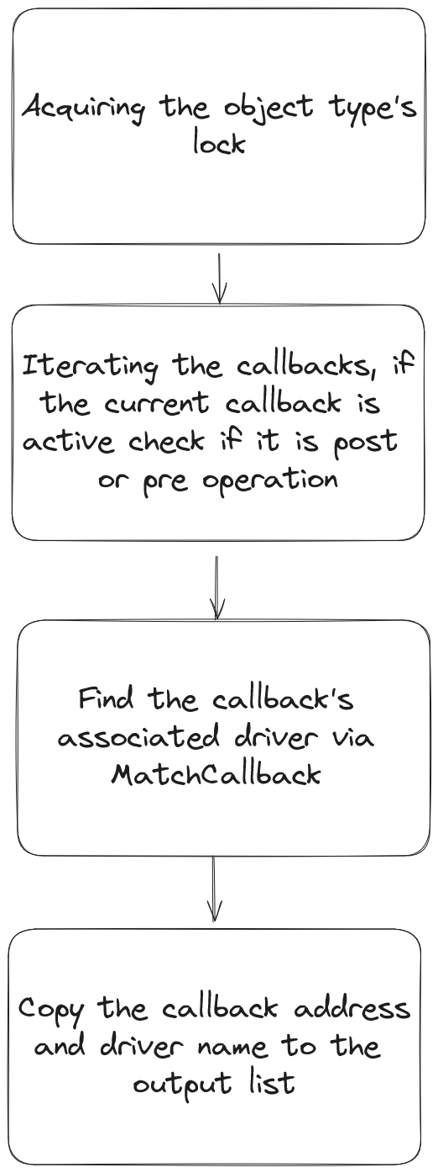
Removing an object callback
Notes:
Explain about the iteration of the callback list, counting how many callbacks there are and matching the driver name to the address Explain about removing an object callback, getting the lock from the object type, iterating over it and if the object callback that should be replaced is found then replace it with dummy that does nothing

Slide 36
Removing an object callback
Notes:
Explain about the iteration of the callback list, counting how many callbacks there are and matching the driver name to the address Explain about removing an object callback, getting the lock from the object type, iterating over it and if the object callback that should be replaced is found then replace it with dummy that does nothing

Slide 37
Removing an object callback
Notes:
Explain about the iteration of the callback list, counting how many callbacks there are and matching the driver name to the address Explain about removing an object callback, getting the lock from the object type, iterating over it and if the object callback that should be replaced is found then replace it with dummy that does nothing

Slide 38
Removing an object callback
Notes:
Explain about the iteration of the callback list, counting how many callbacks there are and matching the driver name to the address Explain about removing an object callback, getting the lock from the object type, iterating over it and if the object callback that should be replaced is found then replace it with dummy that does nothing

Slide 39
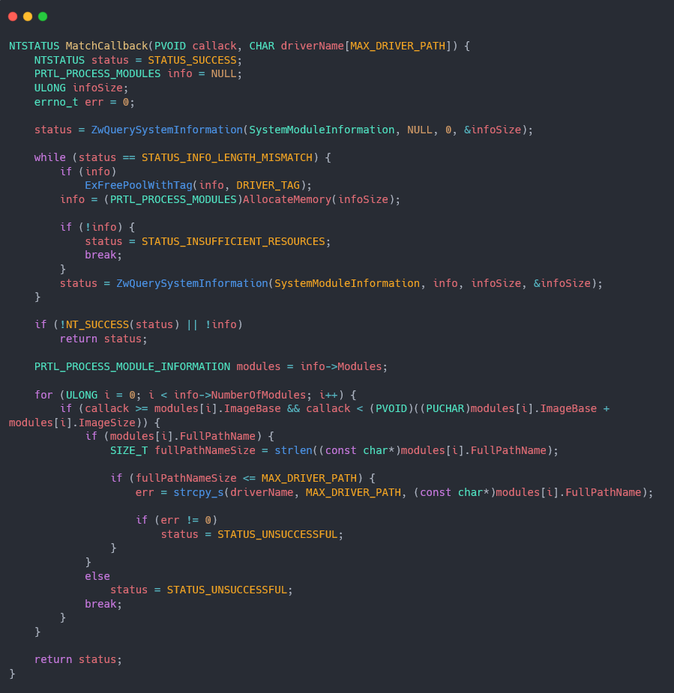
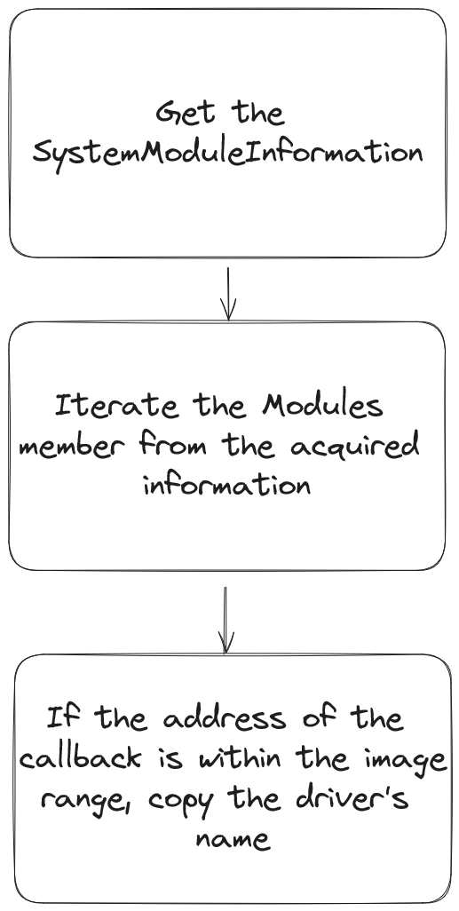
Removing an object callback
Notes:
Explain about the iteration of the callback list, counting how many callbacks there are and matching the driver name to the address Explain about removing an object callback, getting the lock from the object type, iterating over it and if the object callback that should be replaced is found then replace it with dummy that does nothing

Slide 40
Removing an object callback
Notes:
Explain about the iteration of the callback list, counting how many callbacks there are and matching the driver name to the address Explain about removing an object callback, getting the lock from the object type, iterating over it and if the object callback that should be replaced is found then replace it with dummy that does nothing

Slide 41
Removing an object callback
Notes:
Explain about the iteration of the callback list, counting how many callbacks there are and matching the driver name to the address Explain about removing an object callback, getting the lock from the object type, iterating over it and if the object callback that should be replaced is found then replace it with dummy that does nothing

Slide 42
C2 Integration

Slide 43

What is Mythic?
Very popular C2 infrastructure written primarily in Golang by @its-a-feature
Great choice for people that want to write their own agent but not the server side
Highly maintained with lots of pre made agents

Slide 44

Athena
Athena is a cross platform .NET Mythic agent by @checkymander
Has many features such as SOCKS5, P2P agent support, reflective loading of commands and more
In the newest version also added support for all Nidhogg features using a new C# API

Slide 45
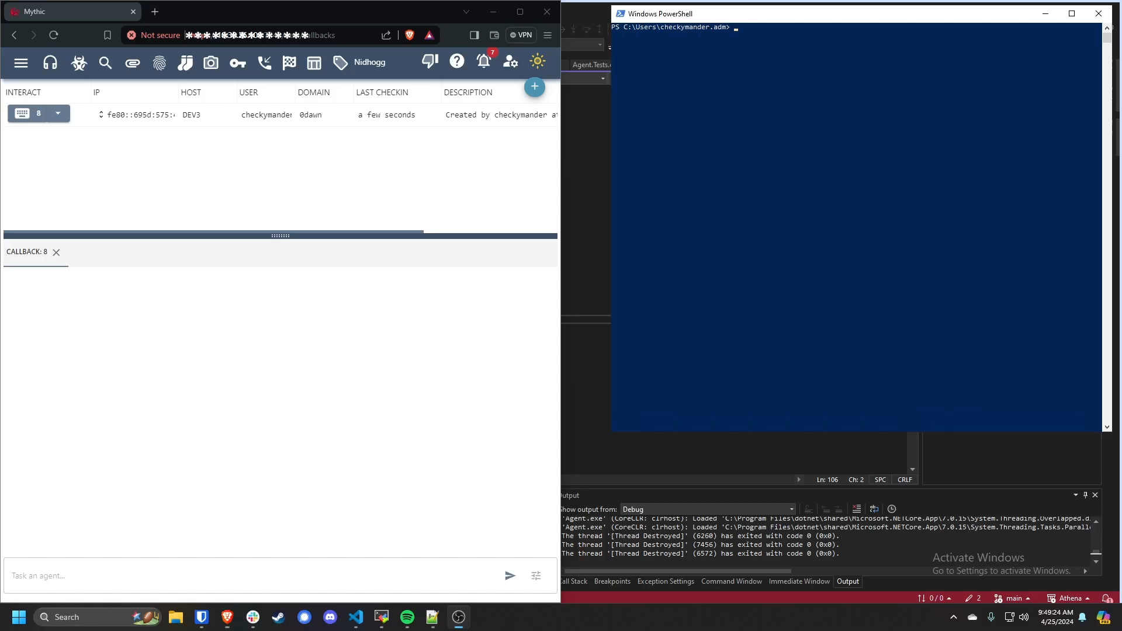
Demo: Process hiding

Slide 46
Detecting Rootkits

Slide 47



Detecting kernel callbacks tampering
Scan periodically for specific kernel object modifications
Be loaded as early as possible
Find the odd callbacks in the prone to malicious activity drivers
Notes:
Explain that there is no callback that can be registered or event that it is raised when a kernel object is modified, explain that it can be used in a watchdog form and monitor specific driver object and explain why Avs and EDRs would want it

Slide 48



What is Etw-TI
ETW provider that gives insights on security related events
Specific syscall monitoring for security vendors
Heavily used by EDRs and AVs for telemetry

Slide 49
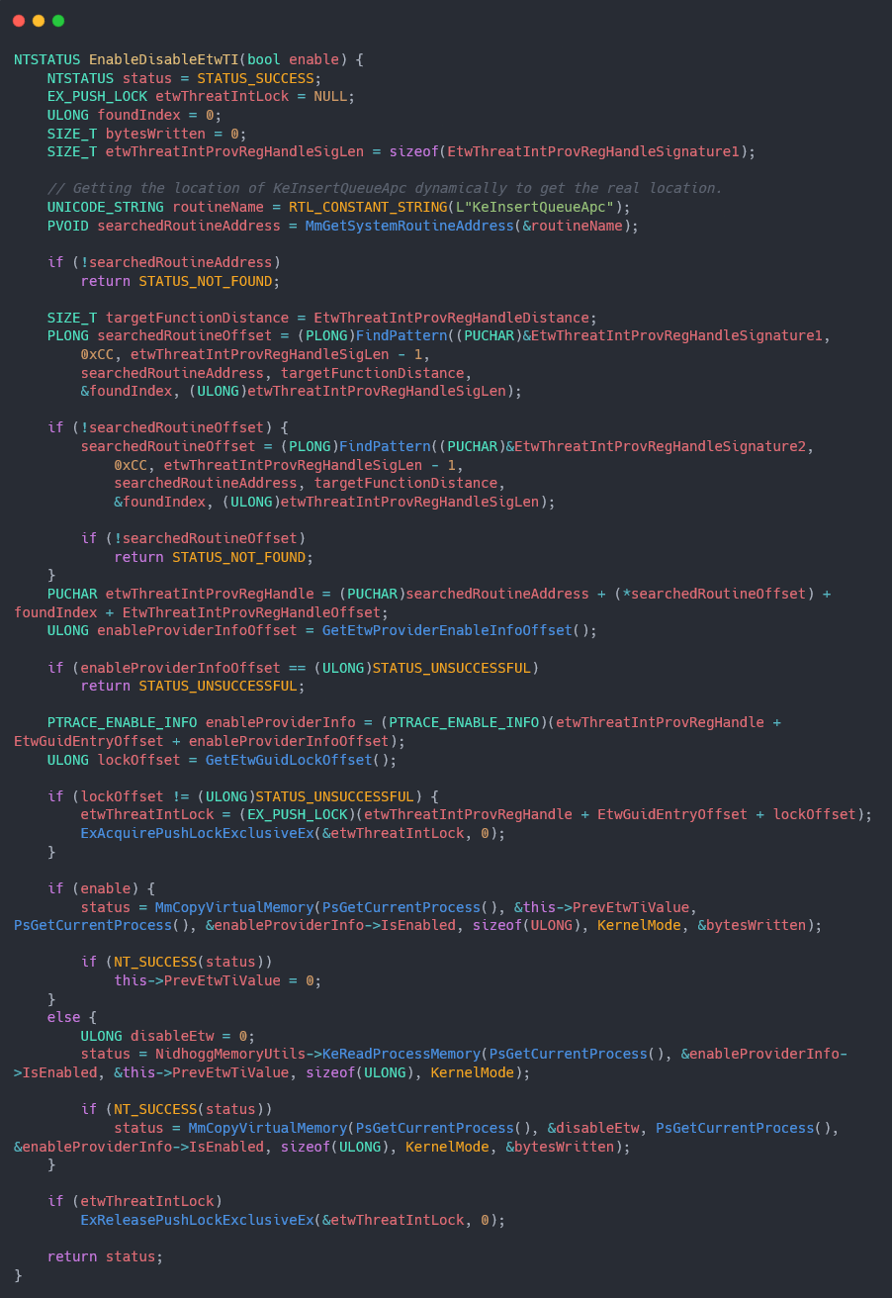
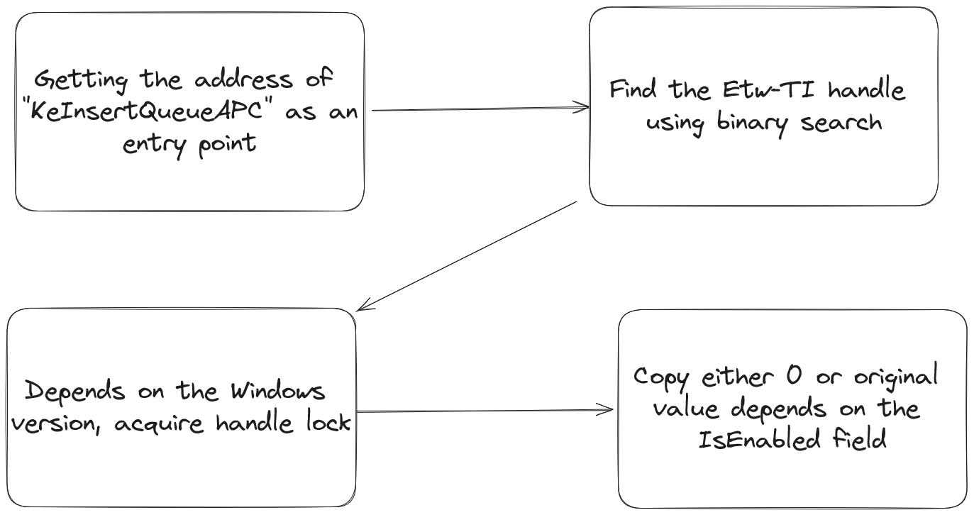
Tampering Etw-TI
Notes:
Go through the code, explain it and then explain how it can be detected

Slide 50
Tampering Etw-TI
Notes:
Go through the code, explain it and then explain how it can be detected

Slide 51
Tampering Etw-TI
Notes:
Go through the code, explain it and then explain how it can be detected

Slide 52
Tampering Etw-TI
Notes:
Go through the code, explain it and then explain how it can be detected

Slide 53


What is IRP hooking?
IRP hooking is when one driver replace a IRP handler of another one with a malicious function
Common hooks are IRP_MJ_DEVICE_CONTROL, IRP_MJ_READ/WRITE

Slide 54
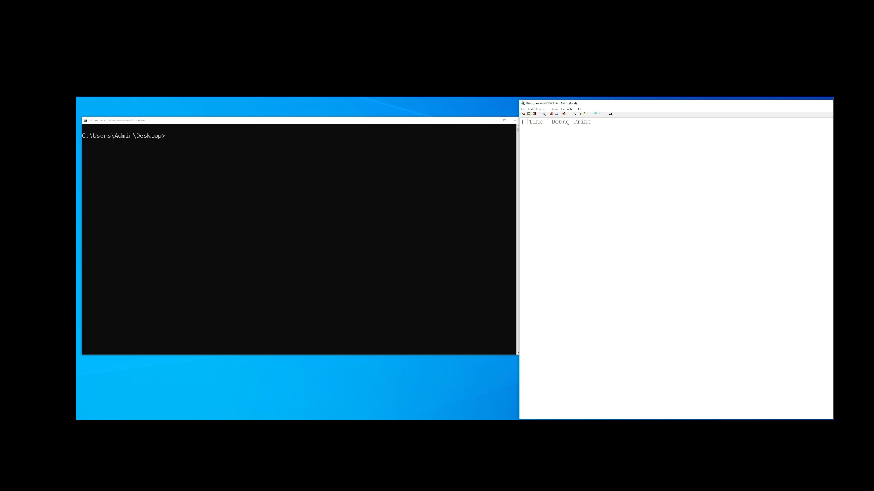
Demo: Detecting IRP hooking

Slide 55
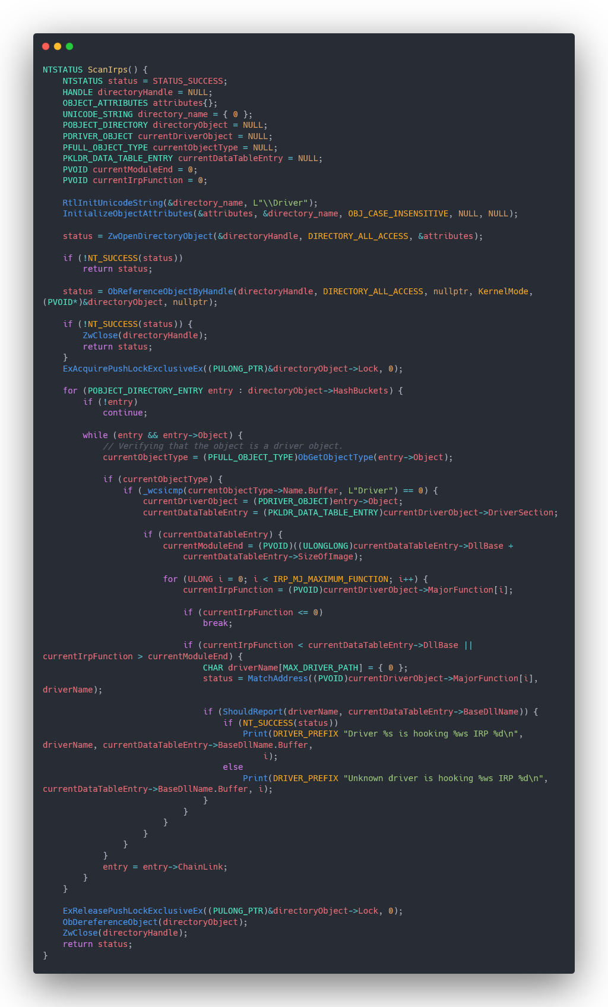
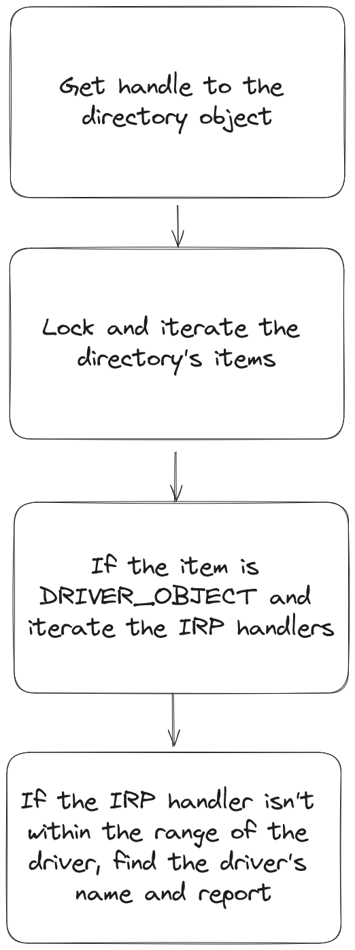
Detecting IRP hook
Notes:
Go through the code, explain it

Slide 56
Detecting IRP hook
Notes:
Go through the code, explain it

Slide 57
Detecting IRP hook
Notes:
Go through the code, explain it

Slide 58
Detecting IRP hook
Notes:
Go through the code, explain it

Slide 59
Summary

Slide 60
Summary
Rootkit Methodologies
Learned how to hide a loaded module
Dumped credentials from the kernel
Removed callbacks of AVs/EDRs
Integration with Mythic C2
Understood what is Mythic C2
Saw a demo of real world usage with Athena and Nidhogg
Detecting Rootkits
Got an idea on how to detect kernel callbacks tampering
Got an idea on how to detect EtwTI tampering
Saw a demo of IRP Hooking detection

Slide 61
Questions?

